Slide 1
Agglomerative clustering

Slide 2
Agglomerative clustering
It is a type of hierarchical clustering algorithm with bottom-up approach.
Where each observation starts in its own cluster and pairs of clusters are merged together as they move up the hierarchy.
Agglomeration means to amass or collect things, which is exactly what this does with the cluster.
The agglomerative approach is more popular type of hierarchical clustering among data scientists.

Slide 3
Inter-cluster distance
There are 4 main ways to calculate the distance between the clusters
Single Linkage clustering
Minimum distance between clusters
Complete Linkage clustering
Maximum distance between clusters
Average Linkage clustering
Average distance between clusters
Centroid Linkage clustering
Distance between cluster centroids

Slide 4
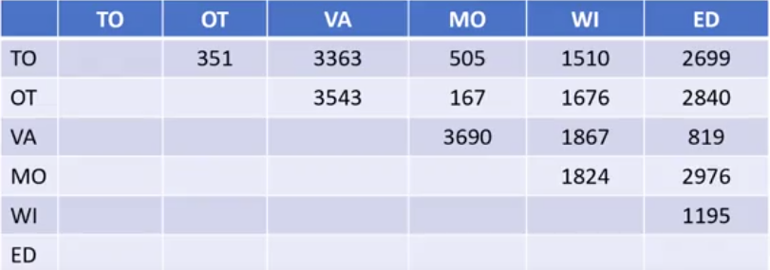
For example: Distance matrix of some cities

Slide 5
For example: Distance matrix of some cities
In this example, we want to cluster six cities in Canada based on their distances from one another.
They are: Toronto, Ottawa, Vancouver, Montreal, Winnipeg and Edmonton.
We construct a distance matrix at this stage, where the numbers in the row i column j is the distance between the i and j cities.
In fact, this table shows the distances between each pair of cities.

Slide 6
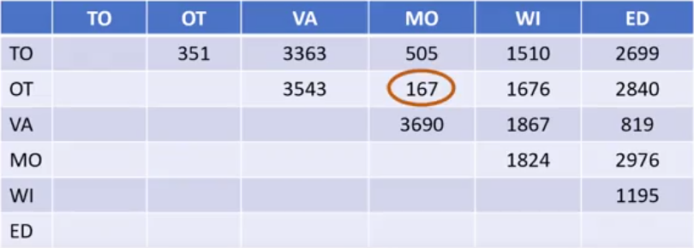
For example: Step 1: Finding the smallest distance and combining the rows and columns

Slide 7
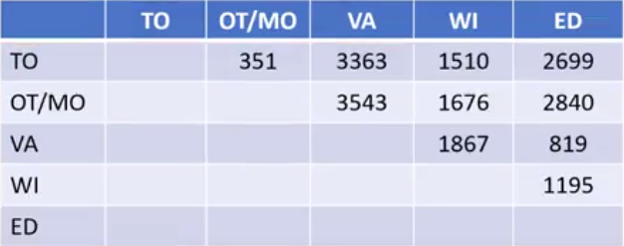
For example: Step 2: Find the next smallest distance and combine the rows and columns

Slide 8
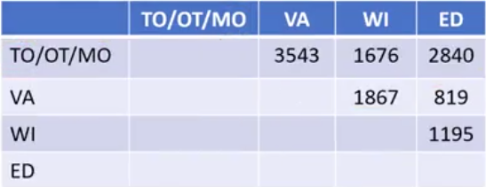
For example: Step 3: Find the next smallest distance and combine the rows and columns

Slide 9
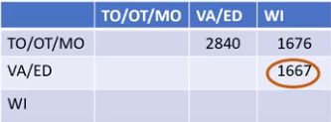
For example: Step 4: Find the next smallest distance and combine the rows and columns

Slide 10

For example: Step 5: Finally we got all our clusters and can be represented as a dendrogram.

Slide 11
Advantages
Doesn’t require number of clusters to be specified
Easy to implement
Produces a dendrogram which helps with understanding the data
Dis-advantages
Cannot undo the previous steps throughout the algorithm
Generally have long runtimes

Slide 12
Summary
Hierarchical clustering is typically visualized as a dendrogram as shown on this slide.
Each merge is represented by a horizontal line.
The y-coordinate of the horizontal line is the similarity of the two clusters that were merged where cities are viewed as singleton clusters.
By moving up from the bottom layer to the top node, a dendrogram allows us to reconstruct the history of merges that resulted in the depicted clustering.

Slide 13
Summary
Essentially, hierarchical clustering does not require a pre-specified number of clusters.
However, in some applications we want a partition of disjoint clusters just as in flat clustering.
In those cases, the hierarchy needs to be cut at some point.

